Slide 1
PROJECT EVALUATION METHODS
Overview of Different Project Evaluation Techniques.
By
Devisree Tiruveedi
20ECE1040

Slide 2
Importance of Project Evaluation Methods:
Project evaluation methods are systematic processes and techniques used to assess and measure the performance, success, and impact of a project.
Effective Decision Making
Risk Management
Resource optimization

Slide 3
Project Evaluation
Traditional Approach
Modern Approach
Payback Period Method
Post Payback Method
Return Rate of Investment
Net Present Value (NPV)
Internal Rate of Return (IRR)
Profitability Index (PI)

Slide 4
Traditional Approach…..
They focus on measuring a project's success primarily in terms of financial returns and compliance with predefined criteria

Slide 5
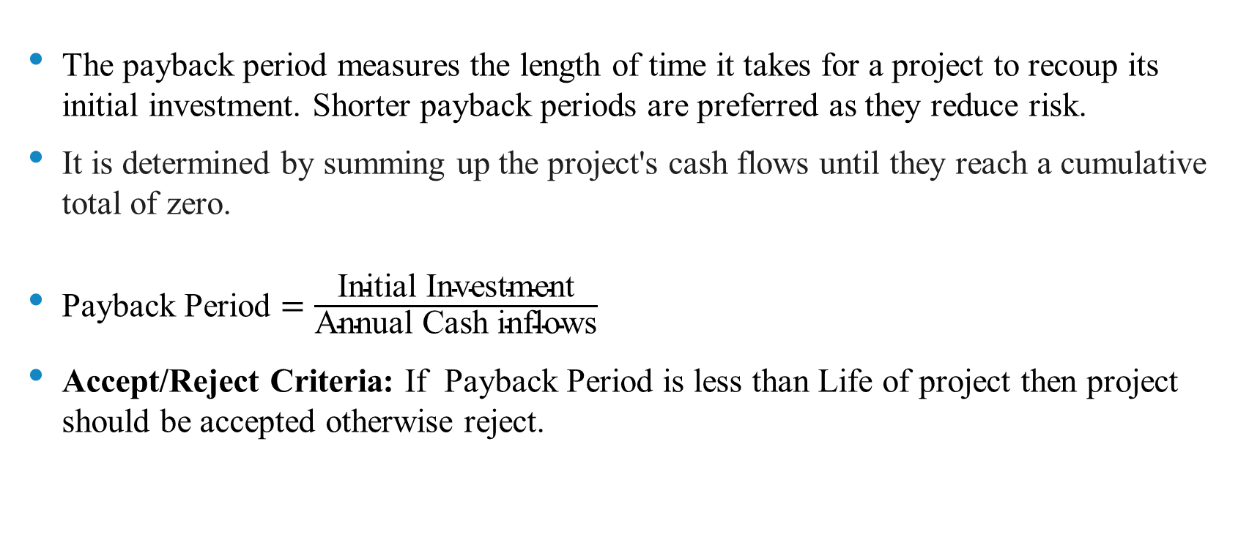
Payback Period Method:
The payback period measures the length of time it takes for a project to recoup its initial investment. Shorter payback periods are preferred as they reduce risk.
It is determined by summing up the project's cash flows until they reach a cumulative total of zero.
Payback Period $=\frac{\text{Initial} \text{Investment}}{\text{Annual} \text{Cash} \text{inflows}}$
Accept/Reject Criteria: If Payback Period is less than Life of project then project should be accepted otherwise reject.

Slide 6
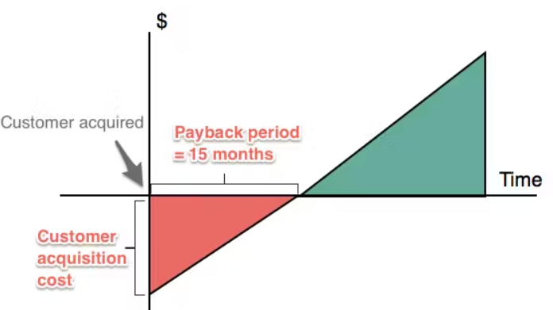
Payback Period Graph

Slide 7
A company invests $30,000 in a project with expected annual cash inflows of $10,000 for a project life of 5 years. What is the payback period for this project, and what does it indicate about the investment's return?
Payback Period = $30,000 / $10,000 per year
Payback Period = 3 years
The payback period for this project is 3 years. This means that it will take 3 years to recover the initial investment of $30,000 from the annual cash inflows of $10,000.

Slide 8
Post Payback Method:
The post payback period is similar to the payback period but also includes the time value of money.
The Post Payback Method focuses on the period after the initial investment has been recovered.
The project that gives the greatest post pay-back period may be accepted.

Slide 9
In the previous example, we calculated the payback period to be 3 years. Now, let's find the cash flows after the payback period:
Total Cash Inflows over 5 years = $10,000 per year x 5 years = $50,000
Cumulative Cash Inflows during the payback period
= $10,000 x 3 years = $30,000
Cash Flows After Payback Period = $50,000 - $30,000 = $20,000
So, the cash flows after the payback period amount to $20,000.

Slide 10
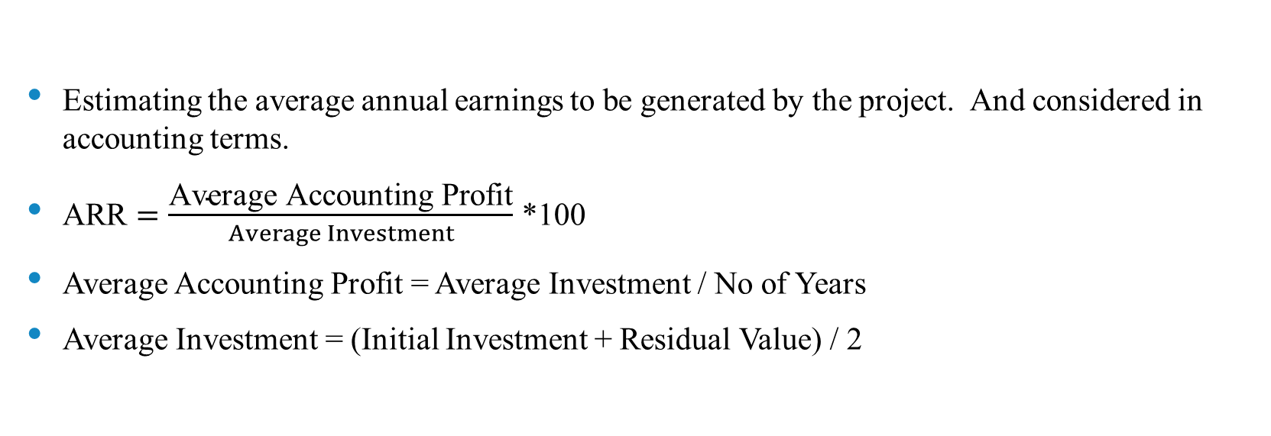
Accounting Rate of Return(ARR)
Estimating the average annual earnings to be generated by the project. And considered in accounting terms.
ARR $=\frac{\text{Average} \text{Accounting} \text{Profit}}{Average Investment}$ *100
Average Accounting Profit = Average Investment / No of Years
Average Investment = (Initial Investment + Residual Value) / 2

Slide 11

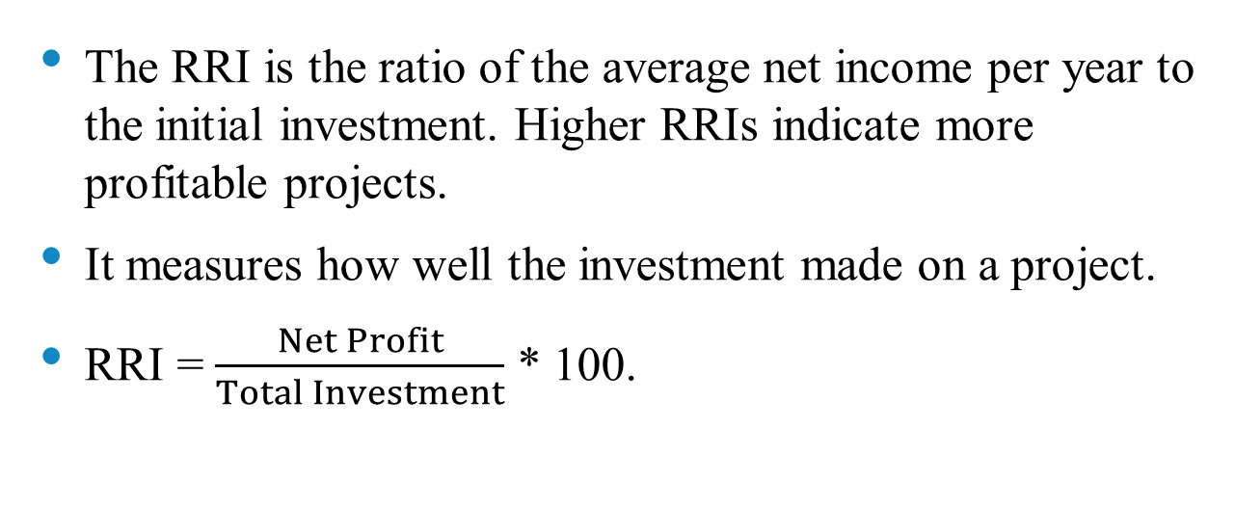
Return Rate of Investment (RRI)
The RRI is the ratio of the average net income per year to the initial investment. Higher RRIs indicate more profitable projects.
It measures how well the investment made on a project.
RRI = $\frac{Net Profit}{Total Investment}$ * 100.

Slide 12
ROI = (Net Profit / Initial Investment) x 100
Net Profit = Total Cash Inflows - Initial Investment
= $50,000 - $30,000 = $20,000
Now, let's calculate the ROI:
ROI = ($20,000 / $30,000) x 100
= (2/3) x 100
= 66.67%

Slide 13
Modern Approach…..
Modern project evaluation often involves sophisticated modeling and sensitivity analysis.

Slide 14

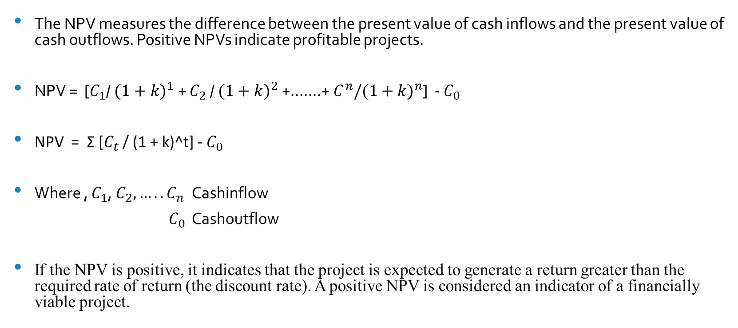
Net Present Value Methods:
The NPV measures the difference between the present value of cash inflows and the present value of cash outflows. Positive NPVs indicate profitable projects.
NPV = [$C_{1}$/ ${(1+k)}^{1}$+ $C_{2}$/ ${(1+k)}^{2}$+…….+ $C^{n}/{(1+k)}^{n}$] - $C_{0}$
NPV = Σ [$C_{t}$ / (1 + k)^t] - $C_{0}$
Where , $C_{1}$, $C_{2}, …..C_{n}$Cashinflow
${ C}_{0}$ Cashoutflow
If the NPV is positive, it indicates that the project is expected to generate a return greater than the required rate of return (the discount rate). A positive NPV is considered an indicator of a financially viable project.

Slide 15
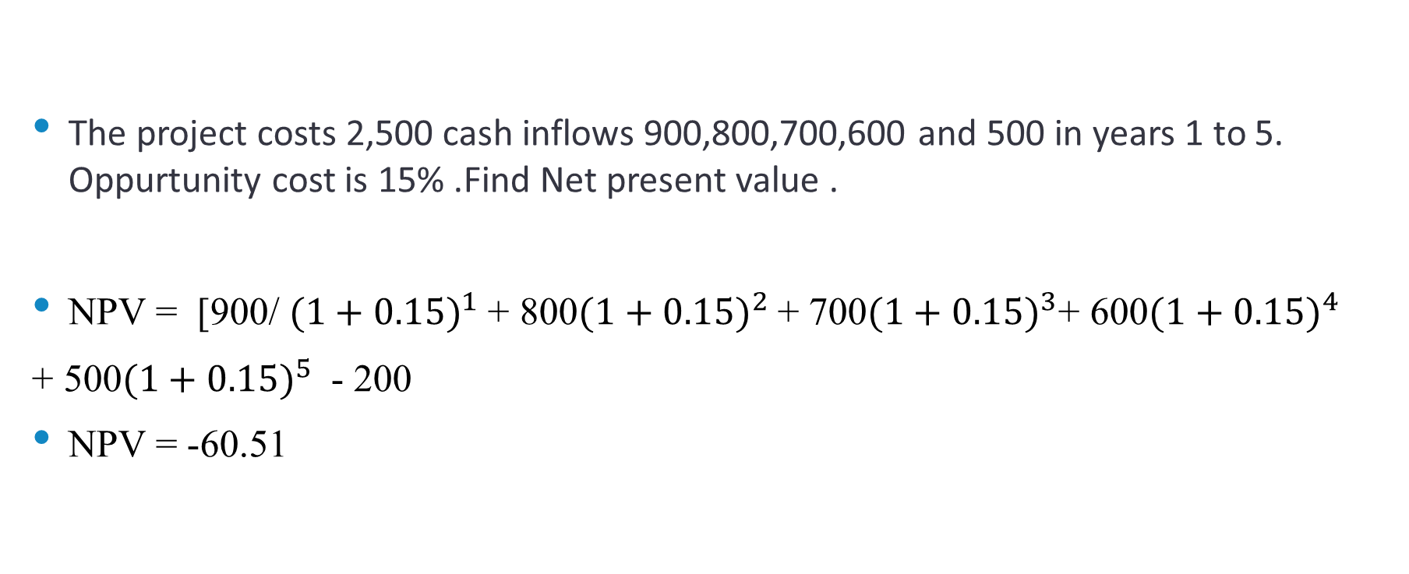
The project costs 2,500 cash inflows 900,800,700,600 and 500 in years 1 to 5. Oppurtunity cost is 15% .Find Net present value .
NPV = [900/ ${(1+0.15)}^{1}$+ 800${(1+0.15)}^{2}$+ 700${(1+0.15)}^{3}$+ 600${(1+0.15)}^{4}$
+ 500${(1+0.15)}^{5}$ - 200
NPV = -60.51

Slide 16
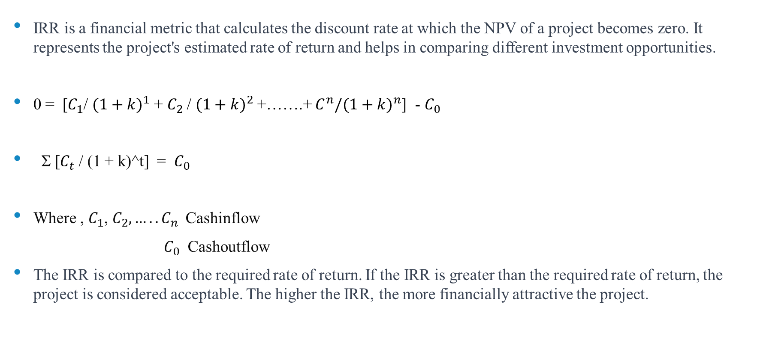
Internal Rate of Return (IRR)
IRR is a financial metric that calculates the discount rate at which the NPV of a project becomes zero. It represents the project's estimated rate of return and helps in comparing different investment opportunities.
0 = [$C_{1}$/ ${(1+k)}^{1}$+ $C_{2}$/ ${(1+k)}^{2}$+…….+ $C^{n}/{(1+k)}^{n}$] - $C_{0}$
Σ [$C_{t}$ / (1 + k)^t] = $C_{0}$
Where , $C_{1}$, $C_{2}, …..C_{n}$Cashinflow
${ C}_{0}$ Cashoutflow
The IRR is compared to the required rate of return. If the IRR is greater than the required rate of return, the project is considered acceptable. The higher the IRR, the more financially attractive the project.

Slide 17
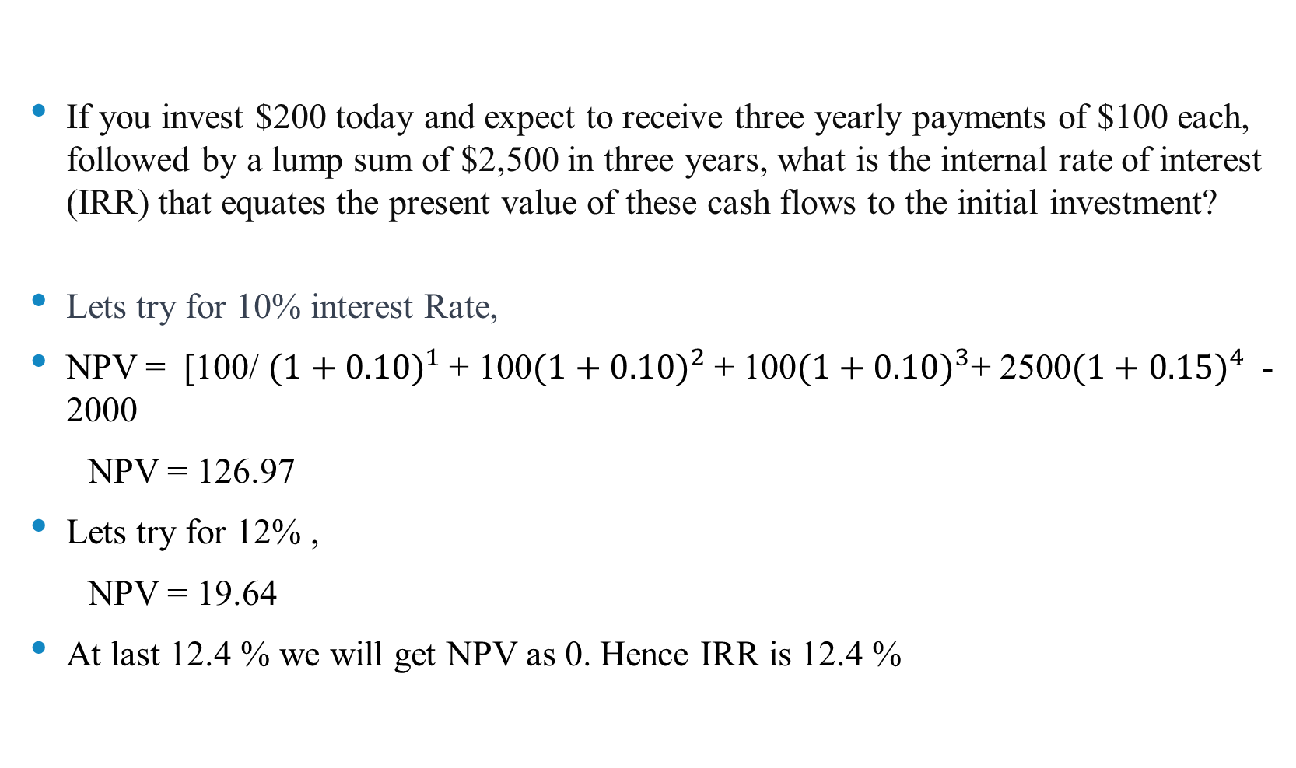
If you invest $200 today and expect to receive three yearly payments of $100 each, followed by a lump sum of $2,500 in three years, what is the internal rate of interest (IRR) that equates the present value of these cash flows to the initial investment?
Lets try for 10% interest Rate,
NPV = [100/ ${(1+0.10)}^{1}$+ 100${(1+0.10)}^{2}$+ 100${(1+0.10)}^{3}$+ 2500${(1+0.15)}^{4}$ - 2000
NPV = 126.97
Lets try for 12% ,
NPV = 19.64
At last 12.4 % we will get NPV as 0. Hence IRR is 12.4 %

Slide 18
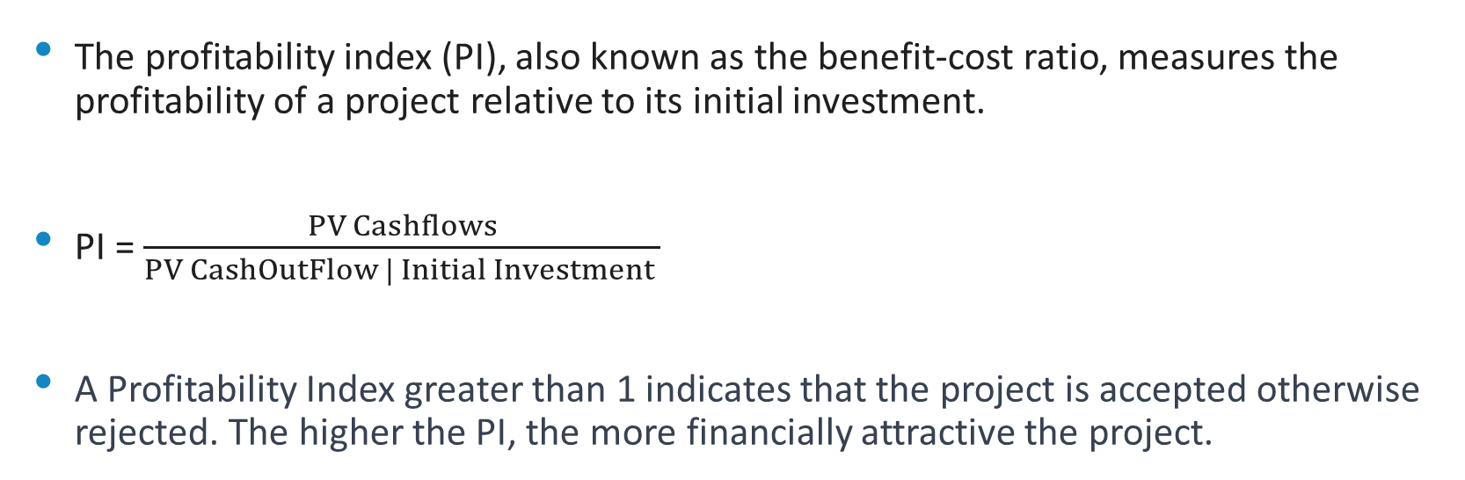
Profitability Index:
The profitability index (PI), also known as the benefit-cost ratio, measures the profitability of a project relative to its initial investment.
PI = $\frac{PV Cashflows}{PV CashOutFlow | Initial Investment }$
A Profitability Index greater than 1 indicates that the project is accepted otherwise rejected. The higher the PI, the more financially attractive the project.

Slide 19
A company invests in a project. The expected annual cash flows are as follows with discount rate 10%.
Year 0 : ₹-15,00,000
Year 1: ₹1,50,000 Year 2: ₹3,00,000 Year 3: ₹5,00,000 Year 4: ₹2,00,000 Year 5: ₹6,00,000
Year 6: ₹5,00,000 Year 7: ₹1,00,000
Year | Amount | PV
0 | -1,500,000
1 | 150,000 | 136,363.64
2 | 300,000 | 247,933.88
3 | 500,000 | 375,657.40
4 | 200,000 | 136,602.69
5 | 600,000 | 372,552.79
6 | 500,000 | 282,236.97
7 | 100,000 | 51,315.81
PV 1,602,663.18
PI 1.06

Slide 20
Criteria for Selecting Project Evaluation Methods
Project scope - complexity, size, and type of project
Resource availability - budget, personnel, equipment, and technology
Time constraints - deadlines, project duration, and scheduling
Decision-making process - involvement of stakeholders, authority, and risk appetite

Slide 21
Thank You……!!

